Slide 1
IT TICKET ANALYSIS
Uday Tamrakar

Slide 2
Problem statement
You are tasked with analyzing the IT support ticket management system to understand the performance of IT agents, the efficiency of ticket resolution, and the satisfaction levels of employees. The objective is to identify high and low performers among IT agents, assess the overall effectiveness of the team, and pinpoint areas for improvement in the ticket resolution process. The ultimate goal is to make informed staffing decisions, including hiring, firing, and training, to enhance overall service quality and team performance.

Slide 3
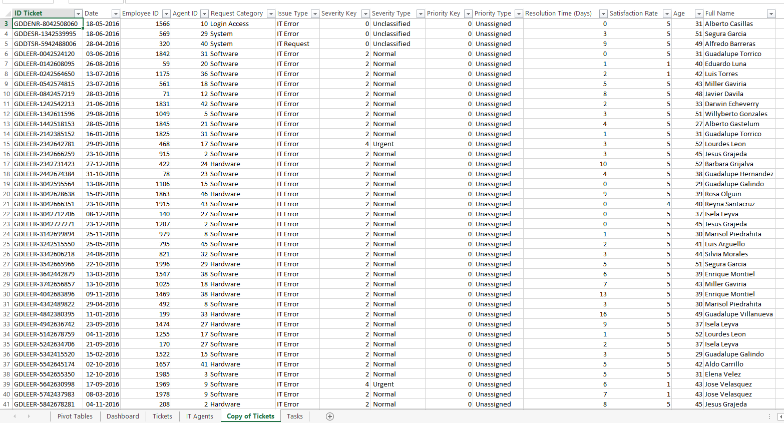
Data of it tickets

Slide 4
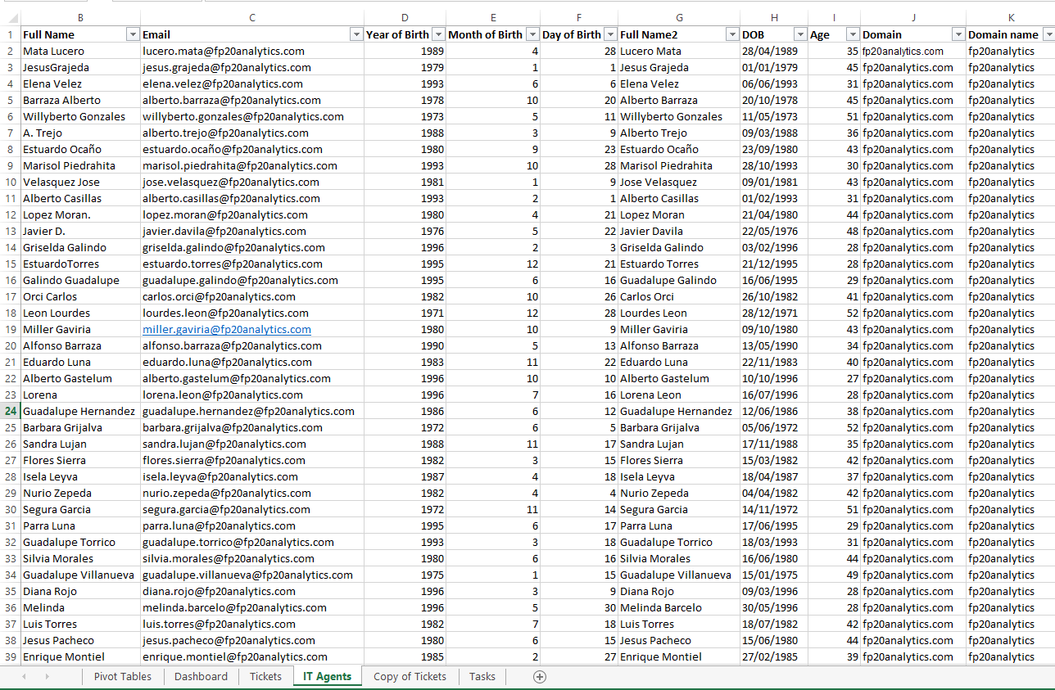
Data of it agents

Slide 5
Data of It tickets
The provided data sheets present two main sets of attributes related to tickets and IT agents:
Ticket Data Sheet (first image):
Ticket ID: Unique identifier for each ticket.
Date: Date the ticket was logged.
Employee ID & Agent ID: Identifiers for the employee raising the issue and the IT agent assigned.
Request Category: Type of request (e.g., login access, system, software, hardware).
Issue Type: IT-related issues (e.g., IT Error, IT Request).
Severity & Priority Type: Levels of urgency and priority.
Resolution Time (Days): Time taken to resolve.
Satisfaction Rate: Employee satisfaction after issue resolution.
Age: Employee age.
Full Name: Employee’s full name.

Slide 6
Data of it AGENTS
Full Name: Agent's full name.
Email: Email addresses of IT agents.
Year/Month/Day of Birth (DOB): Details about the birth date of each agent.
Age: Current age of agents.
Domain: Company's email domain.
Major factors in use are Ticket ID, Request Category, Resolution Time, and Satisfaction Rate from the ticket sheet, and Full Name, Email, and Age from the IT agent sheet. These factors seem central to the analysis of ticket handling and agent performance.

Slide 7
Ticket volume “ Ticket volumes have consistently increased, indicating higher demand on our IT agents. To address this, we need to assess and enhance our current ticket management system for improved efficiency and support. "

Slide 8
TICKET BY SATISFACTION RATE “Investing in advanced tech can boost ticket resolution times and employee satisfaction. With effective implementation and training, we can further enhance our already high satisfaction rates."

Slide 9
Ticket by severity type "While the majority of IT tickets fall into the normal category, we need to focus more on the major category, as it likely impacts critical operations and requires prioritized attention and resources."

Slide 10
Ticket by priority type “Most tickets are categorized as high or unassigned, indicating a need for better prioritization and resource allocation to address urgent issues and manage unassigned tickets more effectively."

Slide 11
Ticket by request category “Most IT tickets are related to login access and system issues, highlighting potential gaps in user onboarding and system stability. To address this, we should enhance authentication processes and improve system reliability to reduce the frequency of these common issues."

Slide 12
TICKET BY ISSUE TYPE AND RESOLUTION TIME BY ISSUE TYPE "Ticket resolution is more frequent in the IT Request category, but the resolution time for these requests is also higher. This indicates a need to streamline the request handling process. Implementing more efficient workflows and automation tools could reduce resolution times and improve overall efficiency."

Slide 13
RESOLUTION TIME BY REQUEST CATEGORY “Resolution times for hardware and system request categories are notably high, indicating potential inefficiencies in handling these issues. To address this, we should streamline processes for these requests, invest in specialized training for staff, and explore automation tools to expedite resolutions."

Slide 14
AVERAGE RESOLUTION TIME AND SATISFACTION RATE BY AGE GROUP. "The average resolution time and satisfaction rate for the 32-36 age group are below expectations. To address this, we should implement targeted training to improve their skills and provide additional resources or support to enhance their performance and customer satisfaction."

Slide 15
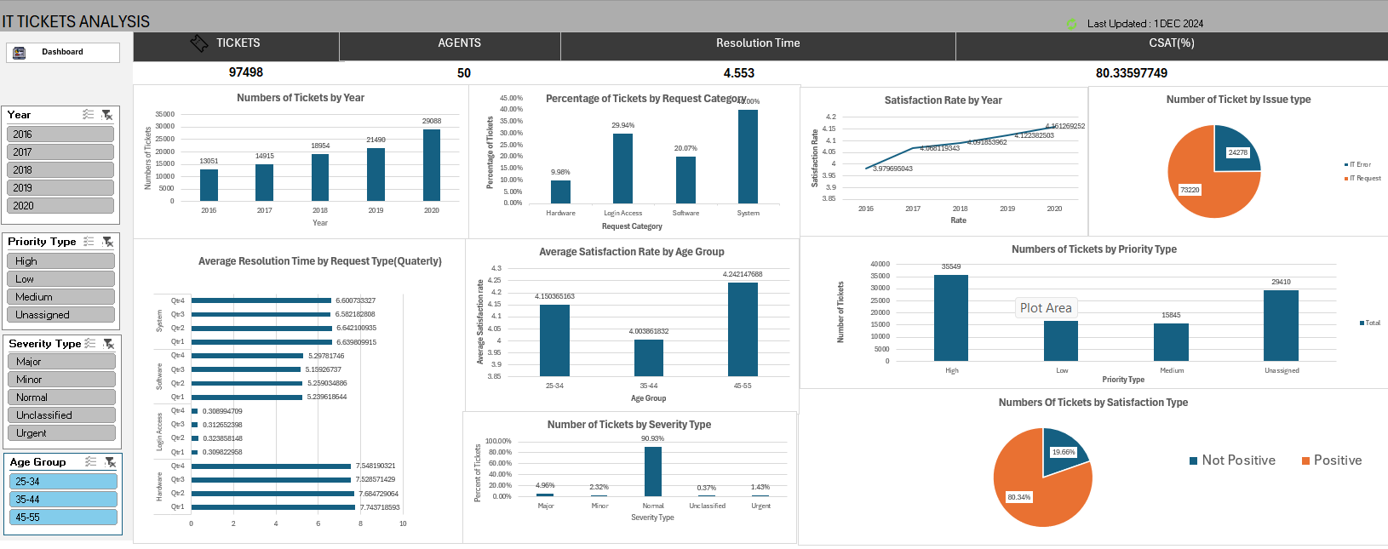
dashboard

Slide 16
SUGGESTIONS:
Increasing Ticket Volumes: Ticket volumes have consistently risen, signaling a higher demand on IT agents.
We need to enhance our ticket management system to improve efficiency and support.
Tech Investment Benefits: Investing in advanced technology can boost ticket resolution times and employee
satisfaction. Effective implementation and training will help enhance these benefits further.
Focus on Major Tickets: While most tickets are categorized as normal, we must prioritize the major category
due to its critical impact on operations, requiring focused attention and resources.
High and Unassigned Tickets: Most tickets fall into high or unassigned categories, highlighting the need for
improved prioritization and resource allocation to manage these effectively.
Common IT Issues: A significant number of tickets relate to login access and system issues, indicating
potential gaps in user onboarding and system stability. Enhancing authentication processes and system
reliability is essential.

Slide 17
IT Request Resolution Time: IT Request tickets are resolved frequently but take longer. Streamlining
workflows and implementing automation tools can reduce resolution times and improve efficiency.
High Resolution Times: Resolution times for hardware and system requests are notably high.
Streamlining processes, investing in specialized training, and exploring automation tools can expedite
these resolutions.
Age Group Performance Disparity: The 42-46 age group handles the majority of tickets, while the 32-36 age
group handles the least. Targeted training and support for the younger group can balance workload distribution.
32-36 Age Group Challenges: The average resolution time and satisfaction rate for the 32-36 age group are
below expectations. Implementing targeted training and providing additional resources can enhance their
performance.
Resource Allocation and Efficiency: Addressing high ticket volumes and improving resolution times
requires better prioritization, efficient workflows, and strategic resource allocation to enhance overall IT
support effectiveness.

Slide 18
CONCLUSION
To enhance IT support, we should:
- Boost Efficiency: Invest in advanced technology to streamline ticket management and reduce resolution times.
- Prioritize Critical Issues: Focus on major ticket categories and improve system stability.
Optimize Resource Allocation: Improve prioritization and address high and unassigned ticket categories
effectively.
- Enhance Training: Provide targeted training and support, especially for age groups with lower performance.
- Balance Workloads: Distribute tasks more evenly to maximize team effectiveness and satisfaction.
These steps will improve performance, efficiency, and satisfaction, preparing us for future demands.

